Slide 1



CSE 2213:
Discrete Mathematics
Modified Slides (based on the source mentioned below):
Originals slides by Dr. Baek and Dr. Still, adapted by J. Stelovsky
Based on slides Dr. M. P. Frank and Dr. J.L. Gross
Provided by McGraw-Hill
1-1

Slide 2



Lecture 08
Chapter 2. Basic Structures
2.3 Functions

Slide 3


2.3 Functions
 From calculus, you are familiar with the concept of a real-valued function f,
which assigns to each number x∈R a value
y = f(x), where y∈R.
 But, the notion of a function can also be naturally generalized to the concept of assigning elements of any set to elements of any set. (Also known as a map.)

Slide 4

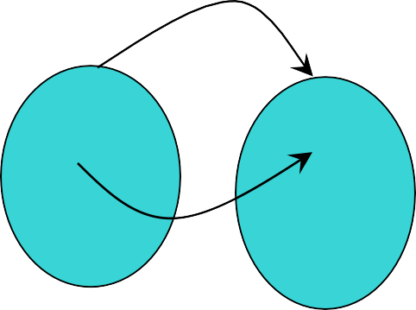
Function: Formal Definition
 For any sets A and B, we say that a function (or “mapping”) f from A to B (f : A → B) is a particular assignment of exactly one element f(x)∈B to each element x∈A.
 Functions can be represented graphically in several ways:
f
A B
•
•
•
•
•
•
•
•
•
y
a
•
•
b
f
A
B
x
Plot
Like Venn diagrams
Bipartite Graph

Slide 5

Some Function Terminologies
 If it is written that f : A → B, and f(a) = b
(where a∈A and b∈B), then we say:
 A is the domain of f
 B is the codomain of f
 b is the image of a under f
 a can not have more than 1 image
 a is a pre-image of b under f
 b may have more than 1 pre-image
 The range R⊆B of f is R = {b | ∃a f(a) = b }

Slide 6

Range versus Codomain
 The range of a function might not be its whole codomain.
 The codomain is the set that the function is
declared to map all domain values into.
 The range is the particular set of values in the codomain that the function actually maps elements of the domain to.

Slide 7
Range vs. Codomain: Example
 Suppose I declare that: “f is a function mapping students in this class to the set of grades {A, B, C, D, F}.”
 At this point, you know f ’s codomain is:
_^{{A,} _^{B, C, D}_,_^{F}_}_, and its range is _unknown!
 Suppose the grades turn out all As and Bs.
 Then the range of f is _^{{A,}_^{B}} , but its codomain is _still {A,_B, C, D_, _F_}_!

Slide 8
Function Operators
 + , × (“plus”,“times”) are binary operators over R. (Normal addition & multiplication.)
 Therefore, we can also add and multiply two
real-valued functions f,g: R → R:
 (f + g): R → R, where (f + g)(x) = f(x) + g(x)
 (fg): R → R, where (fg)(x) = f(x)g(x)
 Example 6:
Let f and g be functions from R to R such that f(x) = x² and g(x) = x – x². What are the functions f + g and fg?

Slide 9

Function Composition Operator
Note the match here. It’s necessary!
 For functions g: A → B and f : B → C, there is a special operator called compose (“◦”).
 It composes (creates) a new function from f and
g by applying f to the result of applying g.
 We say (f ◦ g): A → C, where (f ◦ g)(a) = f(g(a)).
 Note: f ◦ g cannot be defined unless range of g
is a subset of the domain of f.
 Note g(a)∈B, so f(g(a)) is defined and ∈C.
 Note that ◦ is non-commuting. (Like Cartesian ×, but unlike +, ∧, ∪) (Generally, f ◦ g ≠ g ◦ f.)

Slide 10
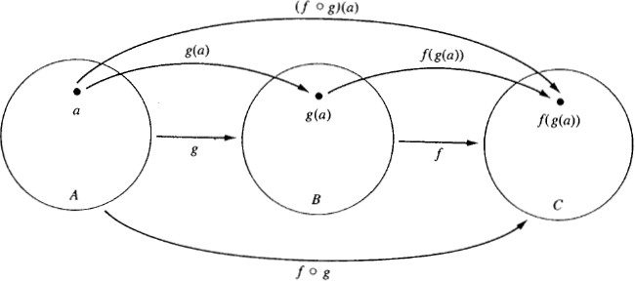
Function Composition
Illustration
 g: A → B, f : B → C

Slide 11
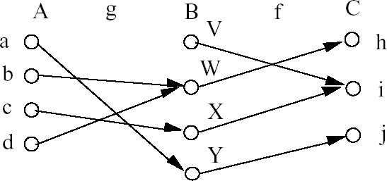
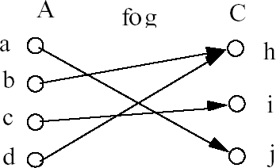
Function Composition:
Example
 g: A → B, f : B → C
f ◦ g

Slide 12

Function Composition:
Example
 Example 20: Let g: {a, b, c} → {a, b, c} such that
g(a) = b, g(b) = c, g(c) = a.
Let f : {a, b, c} → {1, 2, 3} such that
f(a) = 3, f(b) = 2, f(c) = 1.
What is the composition of f and g, and what is the composition of g and f ?
 f◦g: {a, b, c} → {1, 2, 3} such that (f◦g)(a) = 2, (f◦g)(b) = 1, (f◦g)(c) = 3.
f(g(a)) = f(b) = 2
f(g(b)) = f(c) = 1
f(g(c)) = f(a) = 3
(f◦g)(a) = f(g(a)) = f(b) = 2
(f◦g)(b) = f(g(b)) = f(c) = 1
(f◦g)(c) = f(g(c)) = f(a) = 3
 g◦f is not defined (why?)

Slide 13

Function Composition:
Example
 If f(x) = x² and g(x) = 2x + 1, then what is the composition of f and g, and what is the composition of g and f ?
 (f◦g)(x) = f(g(x))
= f(2x+1)
= (2x+1)²
 (g◦f)(x) = g(f(x))
= g(x²)
= 2x² + 1
Note that f◦g ≠ g◦f. (4x²+4x+1 ≠ 2x²+1)

Slide 14


One-to-One Functions
 A function f is one-to-one (1–1), or injective, or an injection, iff f(a) = f(b) implies that a = b for all a and b in the domain of f (i.e. every element of its range has only 1 pre-image).
 Formally, given f : A→B,
“f is injective”: ∀a,b (f(a) = f(b) → a = b) or equivalently ∀a,b (a ≠ b → f(a) ≠ f(b))
 Only one element of the domain is mapped to any given one element of the range.
 Domain & range have the same cardinality.
What about codomain?

Slide 15

One-to-One Illustration
 Bipartite (2-part) graph representations of functions that are (or not) one-to-one:
•
•
•
•
• •
• •
• •
•
•
•
•
•
•
•
•
•
•
•
•
•
•
•
•
•
One-to-one Not one-to-one Not even a function!
 Example 8 (see book):
Is the function f : {a, b, c, d} → {1, 2, 3, 4, 5} with
f(a) = 4, f(b) = 5, f(c) = 1, and f(d) = 3 one-to-one?
 Example 9 (see book):
Let f : Z → Z such that f(x) = x². Is f one-to-one?

Slide 16

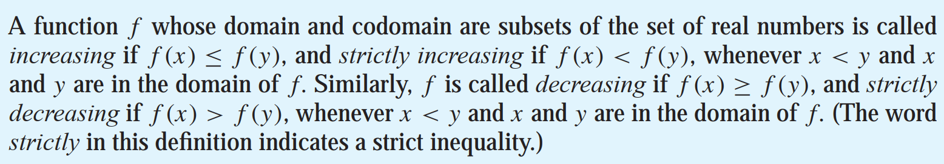
Sufficient Conditions for
1–1ness
 If f is either strictly increasing or strictly decreasing, then f is one-to-one.
 E.g. x³

Slide 17
Onto (Surjective) Functions
 A function f : A → B is onto or surjective or a surjection iff for every element b∈B there is an element a∈A with f(a) = b
(∀b∈B, ∃a∈A: f(a) = b) (i.e. its range is equal to its codomain).
 Think: An onto function maps the set A onto (over, covering) the entirety of the set B, not just over a piece of it.
 E.g., for domain & codomain R, x³ is onto, whereas x² isn’t. (Why not?)

Slide 18
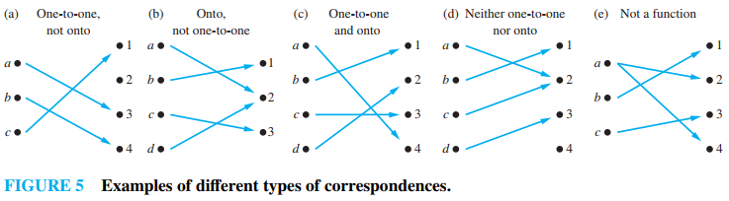
Illustration of Onto
 Some functions that are, or are not, onto their codomains:
 Example13 or Example 14 (any edition): Is the function f(x) = x + 1 from the set of integers to the set of integers onto?

Slide 19
Bijections and Inverse Function
 A function f is said to be a one-to-one correspondence, or a bijection, or reversible, or invertible, iff it is both one-to-one and onto.
 Let f : A → B be a bijection.
The inverse function of f is the function that assigns to an element b∈B the unique element
a∈A such that f(a) = b.
The inverse function of f is denoted by f ⁻¹: B → A. Hence, f ⁻¹(b) = a when f(a) = b.

Slide 20
Finding Inverse of a Function
Example: Find the inverse of f(x) = y = 3x − 2
Solution:
First, replace f(x) with f(y).
Now, the equation y = 3x − 2 will become,
x = 3y − 2
Solve for y,
y = (x + 2)/3
Thus, the inverse of y = 3x − 2 is y = (x + 2)/3

Slide 21
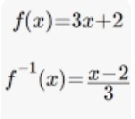
Finding Inverse of a Function
f(x)=3x+2
y = 3x+2
By swapping x and y,
x = 3y+2
3y = x-2
y = (x-2)/3
This is the inverse, hence:
f⁻¹(x) = (x-2)/3

Slide 22
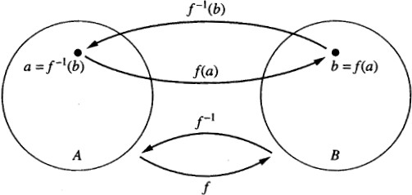
Inverse Function Illustration
 Let f: A → B be a bijection
 Example 16: Let f : {a, b, c} → {1, 2, 3} such that
f(a) = 2, f(b) = 3, f(c) = 1. Is f invertible, and if it is,
what is its inverse? Yes. f^{–1}(1) = c, f^{–1}(2) = a, f^{–1}(3) = b
 Example 18: Let f be the function from R to R with
f(x) = x². Is f invertible?
No. f is not a one-to-one function. So it’s not invertible.

Slide 23
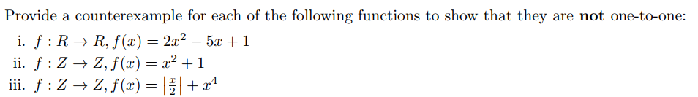
Few Examples

